Slide 1
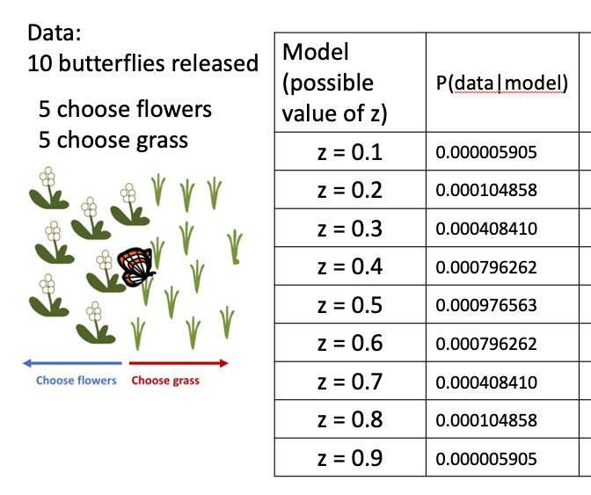
Likelihood Profiles
You’ve already done this!
Start with a range of possible values of a parameter
Calculate likelihood
Parameter value that maximizes likelihood is the maximum likelihood estimate (MLE)
Plot the likelihood values (y-axis) against the possible parameter values (x-axis) to visualize where the MLE is

Slide 2

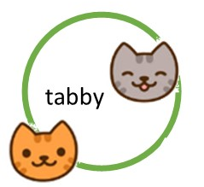


Also likelihood profiles (lecture2challenge2.Rmd)
Challenge #2
Calculate the log-likelihood of survival having each of the following values: 0.1, 0.2, 0.3, 0.4, 0.5, 0.6, 0.7, 0.8, 0.9 using the 5-plant data set
Make a graph of the log-likelihood (y-axis) vs. value of survival (x-axis)
Repeat your calculations and plotting using the 10-plant data set.
Try to do this on your own!
Use the c() or seq() functions in R to make a vector of survival values
Combine the survival values and likelihoods into a dataframe to plot with ggplot
0R
Use the plot() function in R: plot(x, y)
Start with just plotting the likelihoods if this feels more intuitive, use exponents
Notes:
e.g., instead of coding surv*surv*surv*surv*(1-surv), code surv^4*(1-surv)

Slide 3
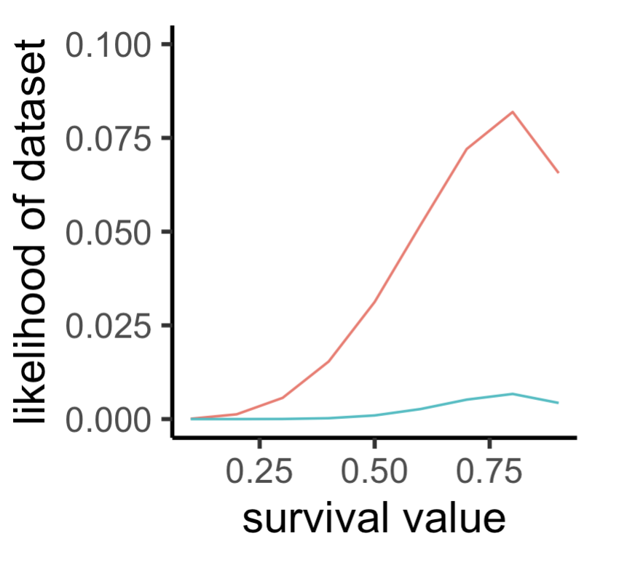
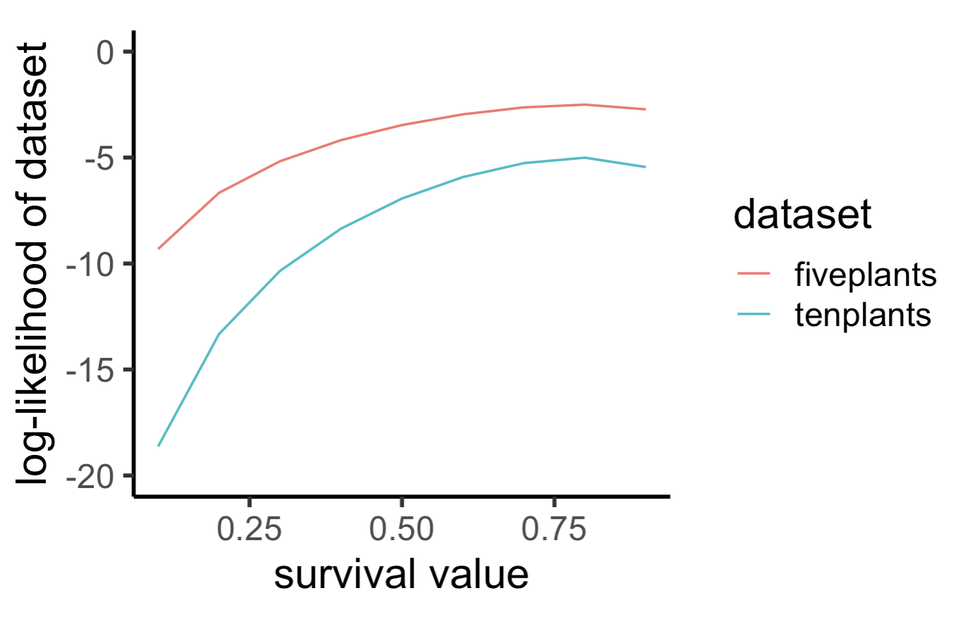
Also likelihood profiles (lecture2challenge2.Rmd)
Notes:
e.g., instead of coding surv*surv*surv*surv*(1-surv), code surv^4*(1-surv)

Slide 4
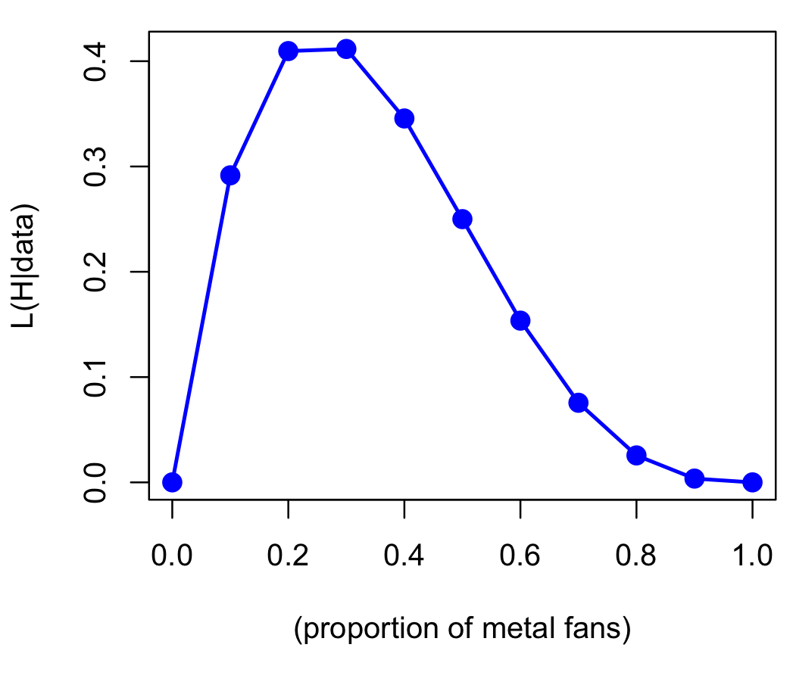

Likelihood profile:
DATA: 4 people, 1 death metal fan
MODELS: values of the proportion who prefer death metal
Model
P(
data|H
)
L(
H|data
)
0.0
0.000
0.000
0.1
0.2916
0.2916
0.2
0.4096
0.4096
0.3
0.4116
0.4116
$$\hat{p}≈0.3$$
0.4
0.3456
0.3456
0.5
0.2500
0.2500
0.6
0.1536
0.1536
0.7
0.0756
0.0756
0.8
0.0256
0.0256
0.9
0.0036
0.0036
1.0
0.0000
0.0000

Slide 5
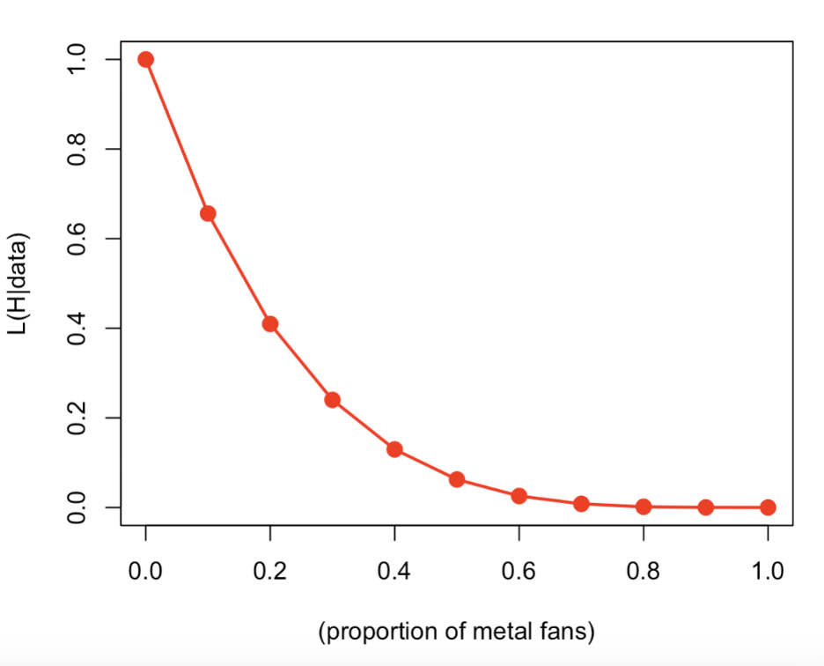
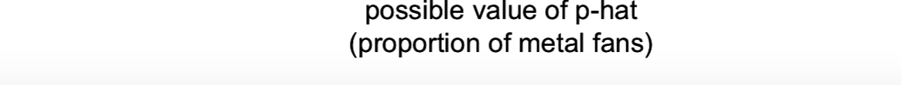

Likelihood profile:
DATA: 4 people, 0 death metal fans
MODELS: values of the proportion who prefer death metal
Model
P(
data|H
)
L(
H|data
)
0.0
1.000
1.000
0.1
0.6561
0.6561
0.2
0.4096
0.4096
0.3
0.2401
0.2401
$$\hat{p}≈0$$
0.4
0.1296
0.1296
0.5
0.0625
0.0625
0.6
0.0256
0.0256
0.7
0.0081
0.0081
0.8
0.0016
0.0016
0.9
0.0001
0.0001
1.0
0.0000
0.0000
Notes:
So the probability of getting our data in which we have 0 people preferring death metal to opera if the proportion who prefer it (the model) is 0 people, is 1, and our estimate of p-hat is then 0

Slide 6
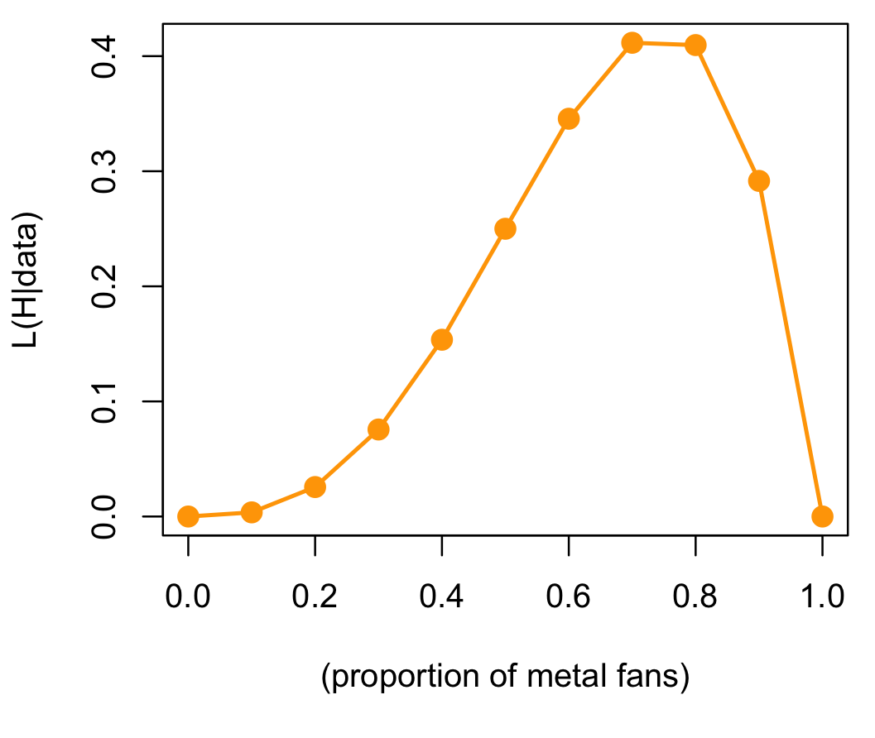

Likelihood profile:
DATA: 4 people, 3 death metal fans
MODELS: values of the proportion who prefer death metal
Model
P(
data|H
)
L(
H|data
)
0.0
0.0000
0.0000
0.1
0.0036
0.0036
0.2
0.0256
0.0256
0.3
0.0756
0.0756
$$\hat{p}≈0.7$$
0.4
0.1536
0.1536
0.5
0.2500
0.2500
0.6
0.3456
0.3456
0.7
0.4116
0.4116
0.8
0.4096
0.4096
0.9
0.2916
0.2916
1.0
0.0000
0.0000

Slide 7
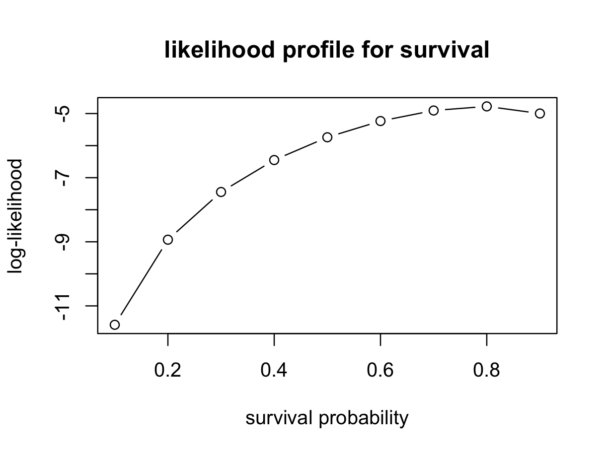
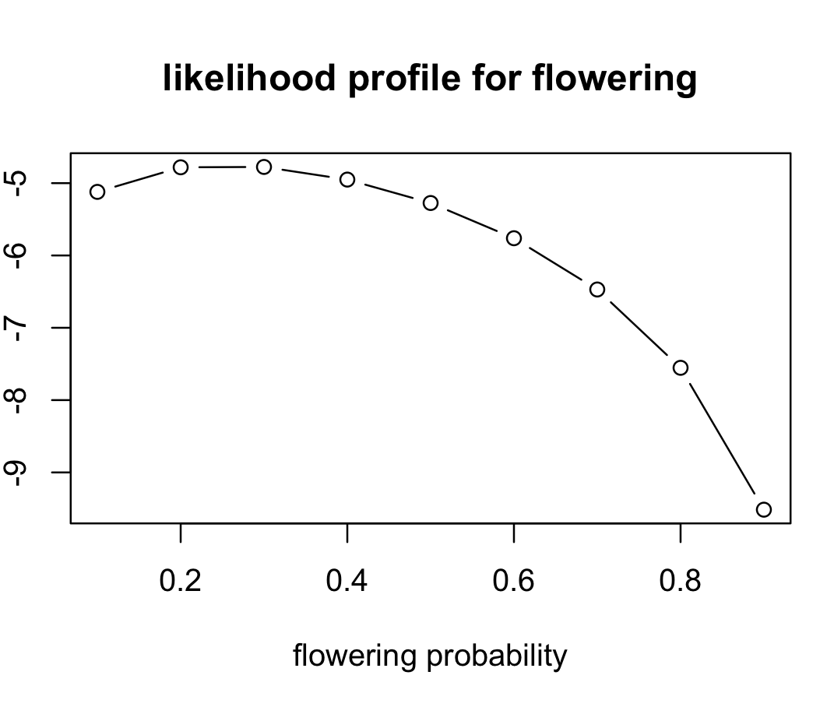
Likelihood Profile from our 5 plant dataset
Notes:
Look across the likelihood profile, which is just our plot of the likelihoods for each of the hypothesized values. We can see here which value has the maximum likelihood
Example for searching across both f and s in R
Here we need something like a loop!!

Slide 8
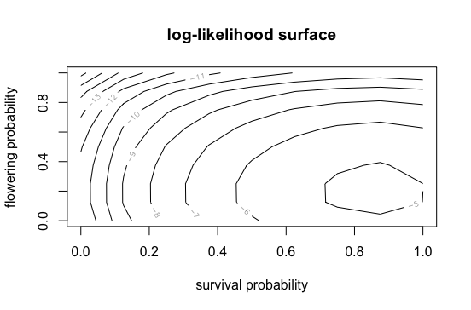
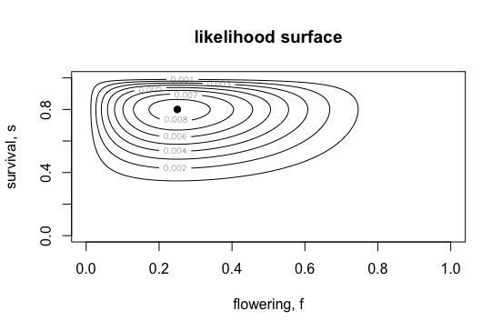
Likelihood Surface = contour plot
Notes:
Example for searching across both f and s at the same time

